Slide 1
Build vs Buy
How To Deploy The Right Video Platform
For Your Needs
Jeff Tapper, Glenn Goldstein,
Dan Balis and Mark Cohen

Slide 2
Agenda
Who we are
Who are you?
Evaluating needs
Our Architectural Principles
Exploring the stack
Summary

Slide 3
Who Are We?
Viacom
Jeff Tapper - SVP Engineering
Glenn Goldstein - Chief Technology Convergence Officer
Dan Balis - Senior Director Video Products
Mark Cohen - VP Engineering

Slide 4
Who are You?

Slide 5
Viacom’s Multiplatform Footprint
Hundreds of millions of users in more than 100 countries…
North and South America, Europe, Asia, Africa
Dozens of major brands and shows…
MTV, VH1, Comedy Central, The Daily Show, @Midnight, BET, Nick, SpongeBob, Dora, Noggin, Rate My Professor, Chronicles of Shannara, Game Shakers
Web, Mobile, Connected TVs
Roku, AppleTV, Xbox, iOS, Android, Apple Watch
Video, Websites, Apps, Games, Books, Audio

Slide 6
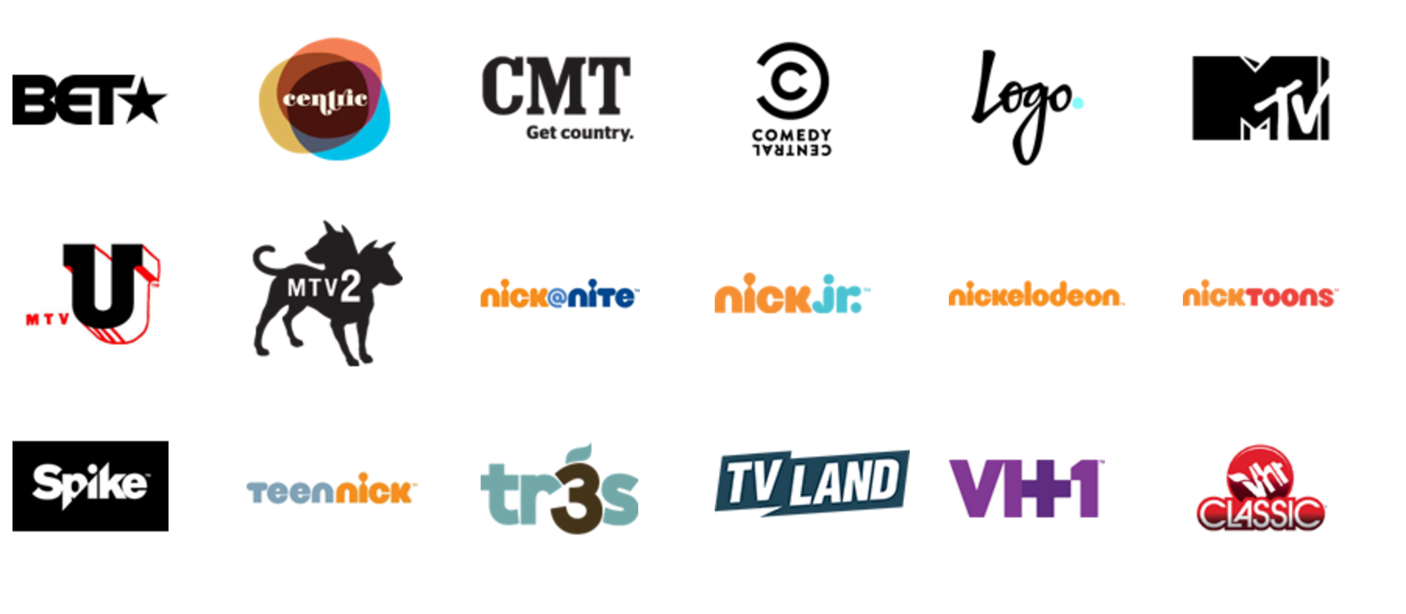
Who is Viacom?

Slide 7
Understanding The Needs

Slide 8
Understanding the Streaming Landscape
There has been a vast proliferation of devices onto which people want streaming video
Wide variety of Codecs available
Wide variety of streaming protocols to choose from
Browsers removing support for some plugins
Browsers native support for streaming video varies

Slide 9
Understanding Formats
Real Time Protocols
RTP, RTMP, RTSP, etc.
HTTP Streaming Protocols
HLS
Smooth Streaming
HDS
MPEG-DASH

Slide 10
Understanding Formats:
Real Time Protocols
Benefits
Liabilities
Very Low Latency
Requires Additional Server Infrastructure
Doesn’t scale well to ultra high volume

Slide 11
Understanding Formats:
HTTP Protocols
Benefits
Liabilities
Very network efficient
Easily cacheable
Utilizes internet standard transport (HTTP)
Works with any web server
Requires packaging before delivery
Higher latency

Slide 12
Understanding Formats :
Smooth Streaming
Created and maintained by Microsoft
Works well with SilverLight, Xbox, Windows 8, and more
DRM possible via PlayReady

Slide 13
Understanding Formats :
HDS
HTTP Dynamic Streaming
Created and maintained by Adobe
Works well with Flash
DRM possible via Primetime DRM (formerly known as Adobe Access)

Slide 14
Understanding Formats :
HLS
HTTP Live Streaming
Created and maintained by Apple
Works well with many devices (iOS, Safari, Roku, etc)
DRM possible (varies based on platform)


Slide 15
Understanding Formats :
MPEG-DASH
Dynamic Adaptive Streaming over HTTP
Open Standard maintained by MPEG
Works well with many devices (Connected TVs, HTML 5 Browsers (MSE), Android, etc.
DRM Agnostic
Extremely flexible format

Slide 16
Understanding the Needs
Engineering Culture
Building your own pieces requires significant engineering talent
You will be responsible for building and maintaining it

Slide 17
Understanding the Needs
Existing Options
Be sure to fully evaluate OTS solutions
Balance cost vs time to integrate / customize

Slide 18
Understanding the Needs
Specific Requirements
Ads / Ad Behaviors
Analytics
Business Rules
Authentication
etc.

Slide 19
Understanding the Needs
Customization vs Time to Customize
It comes down to this:
Cost to Build + Cost to Maintain :: Cost to Buy + Cost to Customize
Don’t forget Time to Market costs, Costs to Operationalize, etc

Slide 20
Our Key Architectural Principles

Slide 21
Our Key Architectural Principles
Integration
Loose Coupling
Separation of Concerns
Backwards Compatibility
Use Third Party Libraries Only as Necessary
Notes:
Loose Coupling
- Asynchronous communication via messaging/event broadcasting when possible. 1 event, many observers/reactions
Backwards Compatibility
Where direct communication between components is necessary, we maintain backwards compatibility whenever possible. Breaking backwards compatibility is a big challenge given all of the clients we serve and not to be taken lightly.

Slide 22
Our Key Architectural Principles
Modularity
DRY (Don’t Repeat Yourself)
High Availability (Our Business is 24x7)
Separation of Concerns
Video Player GUI/Player Engine
Ads & Reporting/Player
D2C/TVE/Player
Notes:
Our player GUI is separate from the player engine.

Slide 23
Our Key Architectural Principles
Customization for each app
Needs to work with stock UI or a completely custom one.
Customization doesn't stop at UI

Slide 24
Our Key Architectural Principles
Extensibility
Minimize touchpoints for customization
Data Model
360 Video
Notes:
Isolate extensions to specific parts of the architecture

Slide 25
Our Approach

Slide 26

VIDEO PLATFORM GOALS
SME 2016 - BUILD OR BUY
SPEED
SCALE
STABILITY

Slide 27
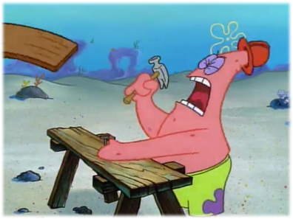
WHAT DID WE DO?
SME 2016 - BUILD OR BUY
Build. (Mostly.)
Why?
Video is our core concern
Make our apps the best place to watch Viacom content
Give our fans best-in-class video experiences
Attain performance at scale across brands and borders

Slide 28
Looking at the Stack

Slide 29
Looking at the Stack
CMS
Encoding
Packaging
Playback
Analytics
Advertising

Slide 30
The Stack - Encoding

Slide 31
The Stack - Packaging
What is it?
Post encoding / pre delivery step
Segmentation of renditions
HLS, DASH, Smooth Streaming, HDS
Server Side Ad Insertion
DRM

Slide 32
Packaging
Dynamic
Static

Slide 33
The Stack - Packaging
Off The Shelf Options
Dynamic Packaging by CDN
Akamai, Level 3, etc
Media Server Solutions
Azure Cloud, Wowza, Adobe Primetime, etc.
Encoding vendors often package as well

Slide 34
The Stack - Packaging
Why might you build your own?
CDN Flexibility
Greater Control

Slide 35
The Stack - Packaging
How would you build your own
Open source packagers available
MP4Box (GPAC)
NGINX packager (Kaltura)
Media File Segmenter (Apple)
Edash (Google)
ffmpeg
etc.

Slide 36
The Stack - Player
What are today's options
Silverlight
Flash
HTML5 (MSE / EME)

Slide 37
The Stack - Player
Silverlight:
Once a dominant player
Native Support for Smooth Streaming / Playready
Relies on NSAPI
Faltering Market share today

Slide 38
The Stack - Player
Flash:
Currently the dominant player for desktop delivery
Native Support for RTMP, HDS
Relies on PAPI
Remains Strong, but world seems to be moving to plugin-less delivery

Slide 39
The Stack - Player
HTML5:
Expected dominant player of the future
No plugins necessary
Native Support for Progressive Download
MSE / EME supports streaming to supported browsers

Slide 40
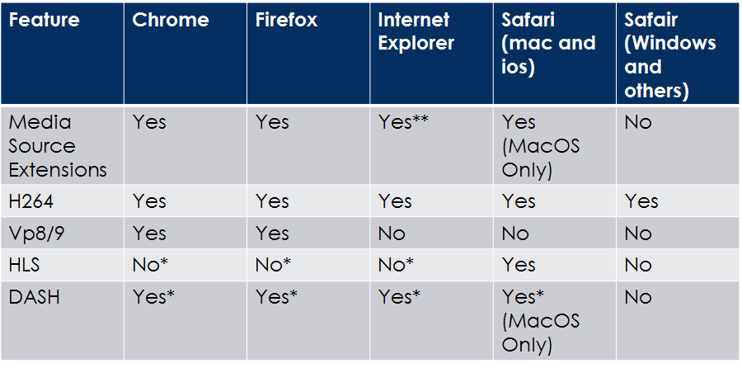
Browsers Today

Slide 41
Understanding Media Source Extensions
MSE allow for pieces (segments) of media to be handed to the HTML5 video tag’s buffer directly.
This enables HTTP Streaming in HTML
Not universally supported, yet.
Currently (as of May 2016) a Candidate Recommendation to the HTML Working Group

Slide 42
The Stack - Player
Off The Shelf Options
Adobe Primetime
Bitdash
Castlabs
Dash.js
Flow
JW
Video.js
And many more…

Slide 43
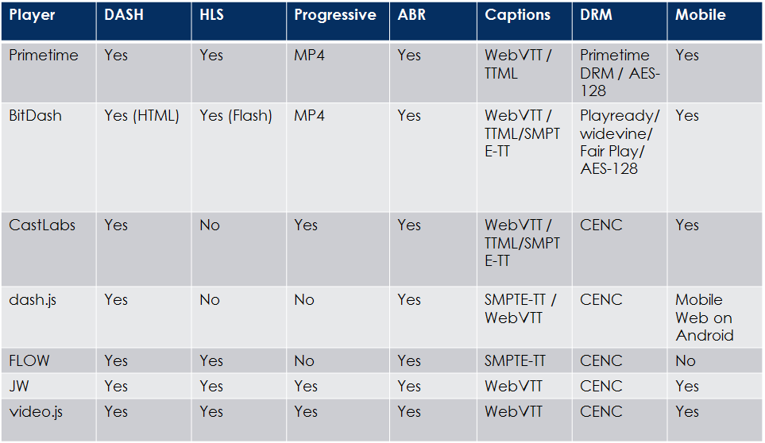
The Stack - Player

Slide 44
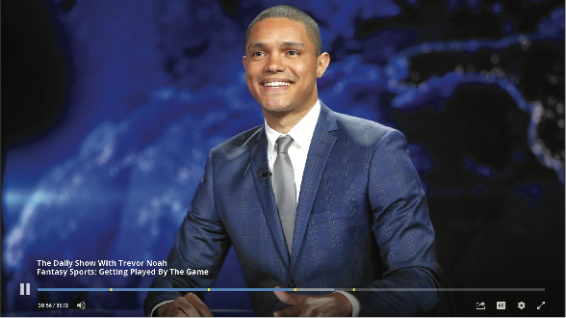
EXAMPLE 1: WEB PLAYER
SME 2016 - BUILD OR BUY
“HLS everywhere”
One codebase for desktop and mobile
Performance
With ads
Easy to integrate
Simple to customize

Slide 45
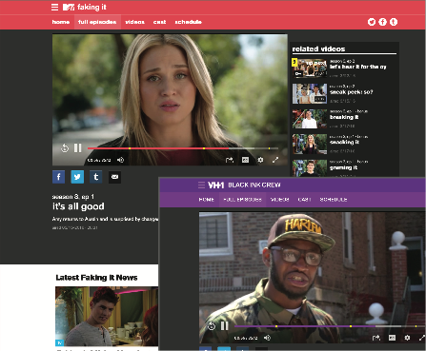
WEB: SOME WINS
SME 2016 - BUILD OR BUY
Uses FlasHLS “shim”
<200K
~1s video start time
Decoupled UI
No iFrames on O&O
WebVTT and 608

Slide 46
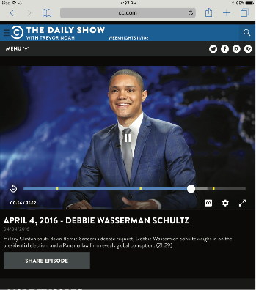
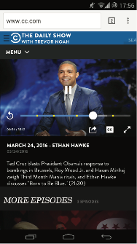
SOME CHALLENGES
SME 2016 - BUILD OR BUY
Mobile web
Ad playback architecture
Upgrade path for MSE
New Product -> Tech Debt

Slide 47

PLAYER INTEGRATION: AS EASY AS…
SME 2016 - BUILD OR BUY
1
Add to HEAD
<script src="http://media.mtvnservices.com/pjs/{uri}"></script>
2
Add to BODY
<div class="MTVNPlayer" data-contenturi="{uri}" data-auto-create></div>
3

Slide 48
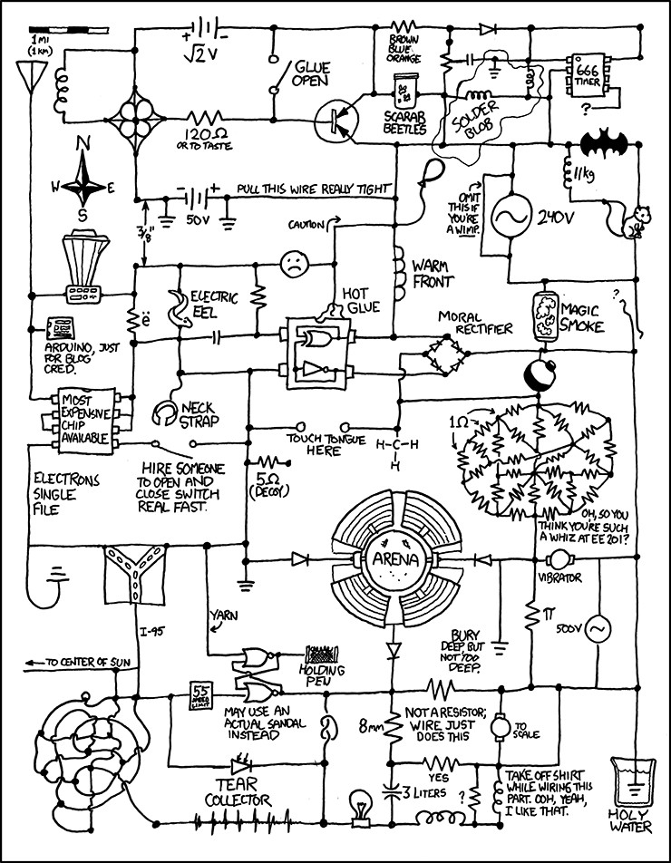
...IT’S SO EASY!!
SME 2016 - BUILD OR BUY

Slide 49
The Stack - Analytics
Two main varieties of analytics
QoE
Measuring Engagement

Slide 50
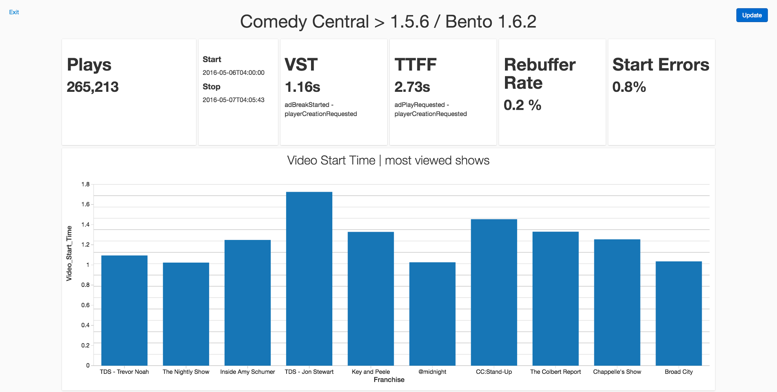
EXAMPLE 2: CROSS PLATFORM QOE
SME 2016 - BUILD OR BUY

Slide 51
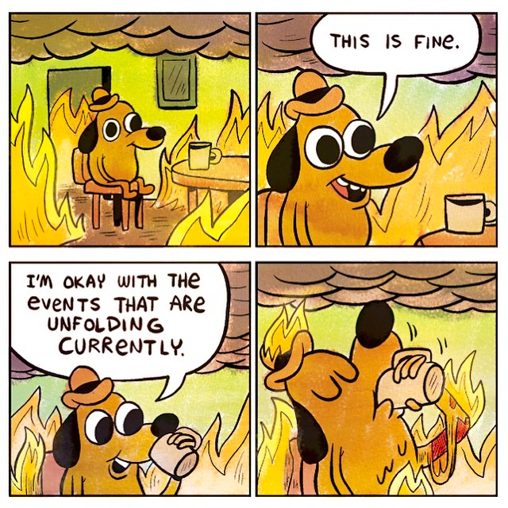
QOE DATA: YOUR MILEAGE MAY VARY
SME 2016 - BUILD OR BUY

Slide 52
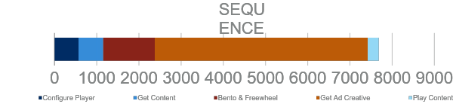
TIME TO FIRST FRAME
SME 2016 - BUILD OR BUY

Slide 53
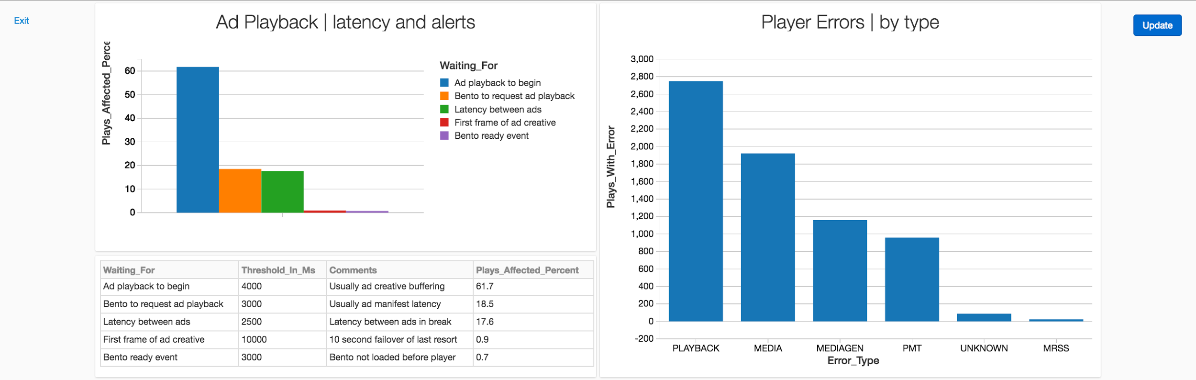
BUILT FOR OUR ECOSYSTEM
SME 2016 - BUILD OR BUY

Slide 54
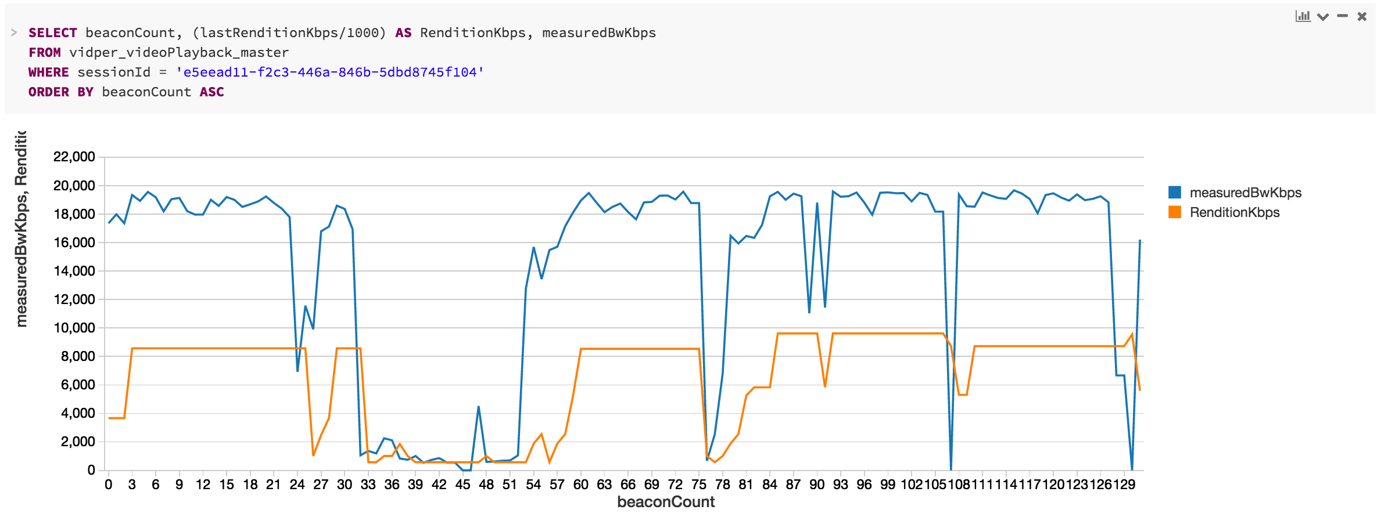
ABR ANALYTICS
SME 2016 - BUILD OR BUY

Slide 55
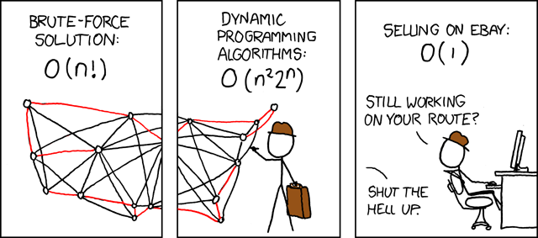
SME 2016 - BUILD OR BUY
NEAR-TERM GOALS
Automated performance testing
Cross-platform parity
Data integrity
Improved visualization
Optimize performance of analytics toolset

Slide 56
QOE AND RETENTION
SME 2016 - BUILD OR BUY
“AFTER A BAD VIDEO EXPERIENCE, 1 IN 5 USERS WILL NEVER RETURN TO THAT SERVICE.”

Slide 57
QOE INSTRUMENTATION
BAD VIDEO EXPERIENCES (BVX)
∑ PLAYS WHERE
(TTFF > 6S OR FATAL ERROR OR RE-BUFFER RATE > 1%)
AND BW > 1 MBPS
∑ PLAYS WHERE BW > 1 MBPS
One KPI to rule them all
Experience as binary classification
Constructive criticism: “too negative”

Slide 58
TOO NEGATIVE?
QOE INSTRUMENTATION
GOOD VIDEO EXPERIENCE (GVX)
GVX = 1 - BVX

Slide 59
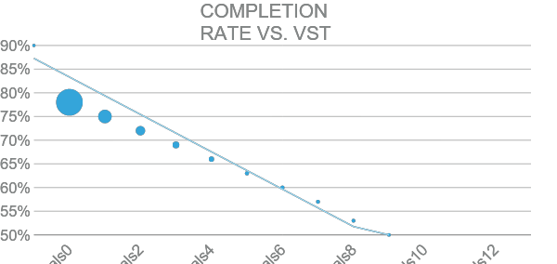
QOE INSTRUMENTATION
LONG-TERM
Engagement as a ƒ(QoE)
Anomaly detection/ML

Slide 60
The Stack - Analytics - QOE
Why might you build your own?
Engineering Talent Exists
Infrastructure Reuse
Customization Required
Company Embraces Open Source

Slide 61
The Stack - Analytics - QOE
How would you build your own?
Open Source Big Data Tech
Look at Use Cases
Still might be worth buying parts

Slide 62

MegaBeacon
Applications
Exploration & visualization
Web
Services
MegaBeacon
Exploration/visualization
App
Video QoE
Playhead Position
Smart TV
Real-time dashboards
Trending content
Video Player
A/B testing
[Your app here]
ETL
BI/Reporting
Notes:
Playhead and Realtime Recs were the initial use cases for this
Good quality reporting

Slide 63
Lambda Architecture
Batch Layer
Serving Layer
Master Dataset
Batch view
New Data
Batch view
Query
Query
Speed layer
Real-time view
Real-time view
Notes:
Nathan Marz

Slide 64





MegaBeacon: A Lambda Architecture Implementation
Batch Layer
Serving Layer
Master Dataset
Amazon S3
&
Batch view
New Data
Apache
Kafka
Batch view
Query
Query
Speed layer
Real-time view
Real-time view

Slide 65
What Do We Pass for Video QoE
Passed from the Player
Client Info: timestamp, content ID, geo data if available, user ID
Ad Info: ad server, contextual data (page)
Packaging: Renditions Available
Playback: many beacons fired per video, bitrate, buffering data

Slide 66
Summary
Understand your specific needs
One size does not need to fit all
Options available for:
CMS , Encoders, Packagers, Players, Analytics, Advertising, etc.
http://github.com/jefftapper

Slide 67
More info
These slides will be available on jeff’s github account
github.com/jefftapper/presentations

Slide 68
Questions?
?

